Slide 1

Lecture 4:
Boolean Expressions and Conditional
Branching presentation
CoTaPP: Computational Thinking and
Programming with Python

Slide 2




Slide 3




Slide 4

Previous lecture
starting with Python
  simple and formatted printouts
  how to read simple user inputs
  the basic data types
  arithmetic expressions
  variables

Slide 5


Slide 6
Today’s lecture
boolean expressions
  allow us to express conditions
  check at runtime if they are true or false
    runtime: when the code is being executed on the computer
if statement
  deviate from the normal sequential control-flow depending on whether a certain condition is true or not
  this allows us to let our program behave differently in different situations
    control flow: the order in which individual statements, instructions or function calls are executed
binary numbers
MasteryGrids

Slide 7
Today’s lecture
Today we will talk about boolean expressions and conditional branching

Slide 8
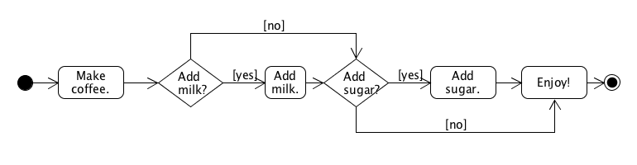
Today’s lecture
Today we will talk about boolean expressions and conditional branching

Slide 9
Today’s lecture
Today we will talk about boolean expressions and conditional branching

Slide 10
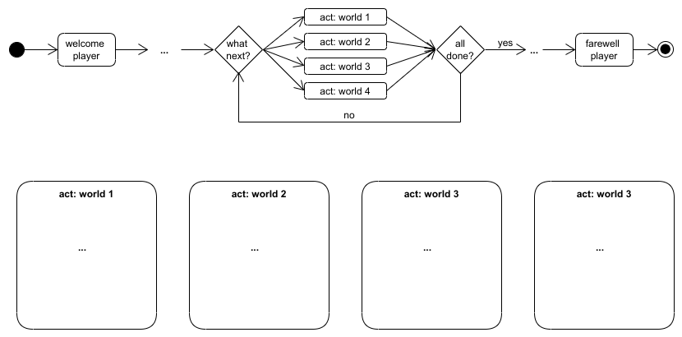

Slide 11


Slide 12
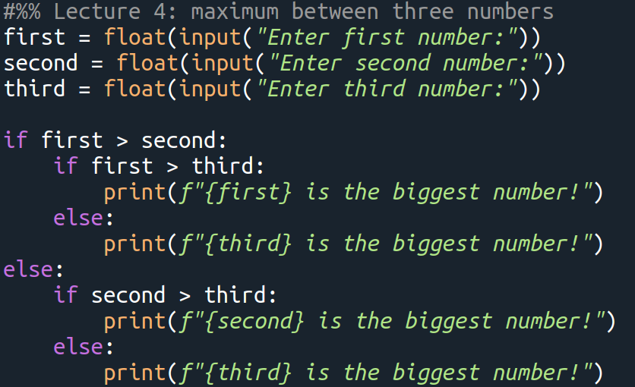

Slide 13
Binary Numbers

Slide 14


Slide 15
Binary Numbers
True/False, 1/0, binary numbers…
Computers work with 1s and 0s
Python is a high-level programming language
  closer to human languages and further from machine languages (1s and 0s)
On the lowest level, the voltage in memory cells is interpreted as 1 (voltage above a certain threshold, present, or True) or 0 (below, not present, or False).

Slide 16
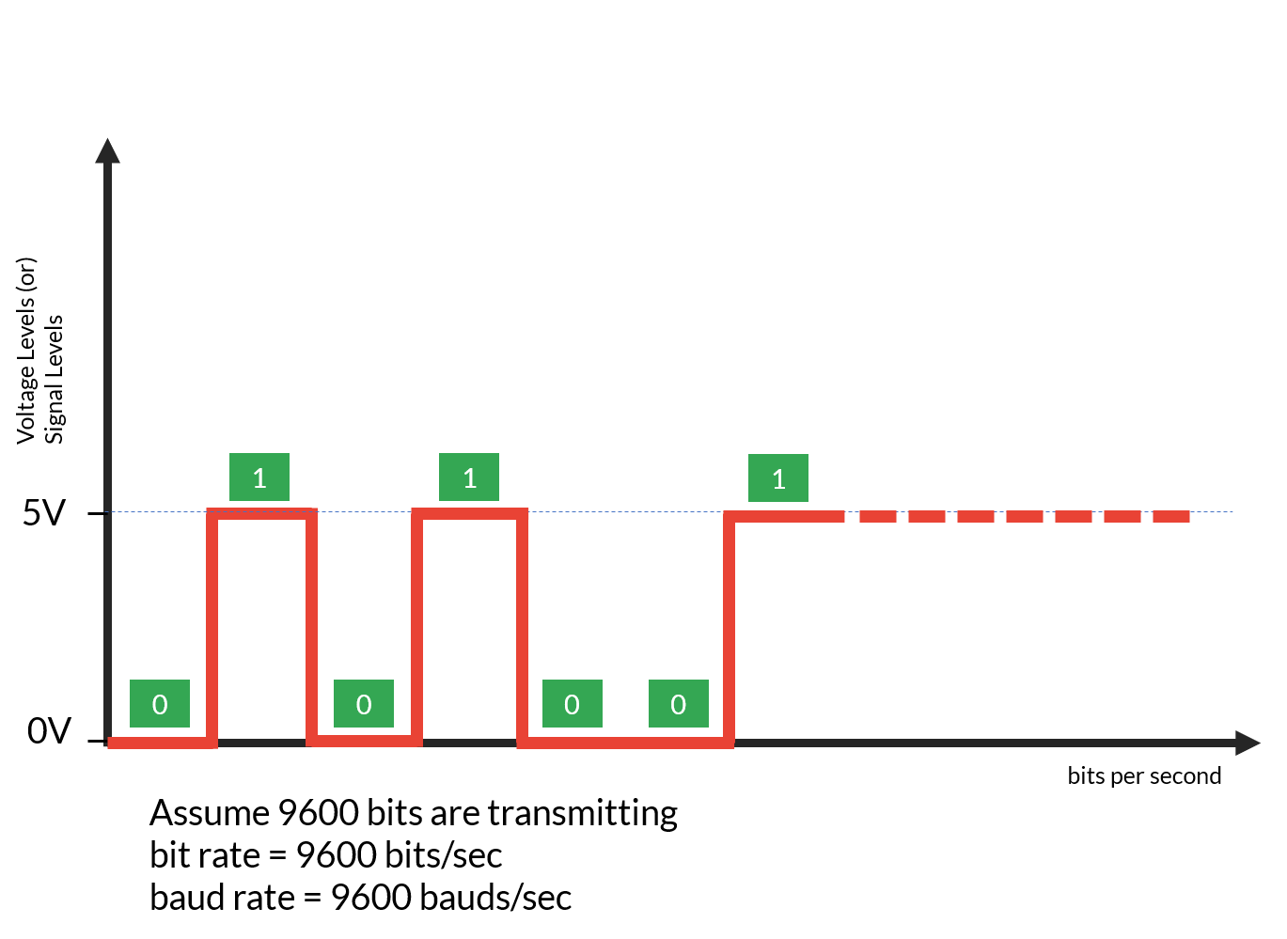

Slide 17

Introduction to
Binary Numbers
Dr. Bob Brown
College of Computing and Software Engineering
Kennesaw State University
Copyright © 2017 by Bob Brown
Notes:
Today we’re going to learn about binary numbers.
Binary numbers are important because all modern computers use only binary numbers internally. If you work more than superficially with computers, you will find binary numbers everywhere.
Even as a casual computer user, you’ll very often see numbers like 8, 16, 32, and 64. Those numbers are powers of two, and we find them in computing because binary numbers are used internally.

Slide 18
Decimal Numbers
3 0 7
Hundreds place
Tens place
Ones place
Decimal numbers are based on powers of ten.
Each place value is ten times the one to its right.
Each place can have one of ten possible digits.
We can write arbitrarily large numbers this way.
Notes:
Let's start with a review. we'll look at the number system we use every day, the ordinary decimal number system.
The decimal number system is a positional number system. That means the decimal number system has place values. On the right we have the ones place and in the example on the slide there are seven ones. The digit in the ones place tells us how many ones contribute to the value of the number as a whole. We start with the ones place because one is ten to the zeroth power.
Moving to the left the next place is the tens place, and in the example there are no tens. The next place after that is the hundreds place, and we have three hundreds, so this number is three hundred and seven.
The next place to the left would be the thousands place, then ten thousands, then hundred thousands, then millions, and we can go as high as we need to.
Decimal numbers are based on powers of ten; ones, tens, hundreds, thousands, and so on. Each place value is ten times the one to its right, so every time we move left we multiply by ten. Each place can have one of ten possible digits including the zero, which means that there is no value assigned by that place. We can write numbers as big as we need them to be. A mathematician would say we can write arbitrarily large numbers using the decimal number system.

Slide 19
Binary Numbers: Powers of Two
Binary numbers are based on powers of two.
Each place value is two times the one to its right.
Each place can have one of two possible digits.
We only need two digit symbols: 0 and 1; call these bits.
Place values are ones place on the right, then
twos place
fours place
eights place … and so on, as high as we need.
Notes:
As I said in the introduction, all modern computers use binary numbers internally. Binary numbers are based on powers of two. They are positional number system like the decimal number system but instead of times ten we're going to use times two.
We start with the ones place on the right because two to the zero power is one. In fact, any number to the zero power is one! Each place value is two times the one on its right. Each place can have one of two possible digits and so we only need two digit symbols, zero for the null or nothing quantity and one for the unit quantity. We call these digits “bits,” a contraction of binary digit. So, when you hear about a 64-bit computer, it’s a computer that does operations on 64 binary digits at a time.
The place values are powers of two. We have the ones place on the right, then a twos place; two times one. Then a fours place; two times two. Then an eights place; two times four, and sixteen and thirty-two and sixty-four and one twenty-eight and two fifty-six, and on as high as we need. So with binary numbers we can also write arbitrarily large numbers. we can make numbers as big as we need using only the digit symbols zero and one.

Slide 20
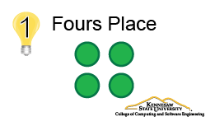
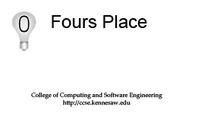
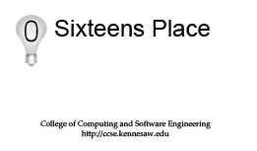

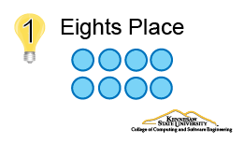


Binary Cards
Notes:
One way to develop a feel for binary numbers is to use cards like the one on the screen. Each card tells the place it occupies and, on the front there’s on “on” lightbulb with a one in it, representing a one in that position. The number of dots on a card shows the value of that position. The back of the card has a zero in the lightbulb and no dots. If a binary digit is zero, it contributes nothing to the value of the number, but serves as a placeholder, just like with decimal numbers.
The examples and exercises use a set of five cards for the ones, twos, fours, eights, and sixteens places. Of course, we can have binary numbers with many more than five digits. With enough bits – binary digits – we can write arbitrarily large numbers.

Slide 21
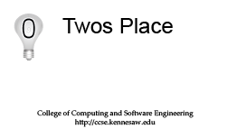
Interpreting Binary Numbers
0 1 1 0 1
Sixteens place
Eights place
Fours place
Twos place
Ones place
Notes:
How do we interpret binary numbers? Well, remember there are only zeros and ones. There's a ones place on the right, then twos, fours, eights, and sixteens.
We have a binary number here on the screen: zero one one zero one, and below the binary number I have placed the flash cards with dots on them the ones place card has one dot, the twos place card has two dots on the front but on the back it has nothing. Because this number has a zero in the twos place. The fours place has four dots, eights place has eight dots, sixteens place sixteen dots on the front but on the back nothing. We've turned the cards over in the positions where there is a zero in the binary number. We could count the dots and find out what the decimal value of that binary number is. There are eight dots for the eights place, four more of the fours place, that's twelve. There are none in the twos place. There's one in the ones place and so we have thirteen dots, and that binary numbers zero one one zero one represents the decimal number thirteen.

Slide 22
Interpreting Binary Numbers
0 1 1 0 1₂ = 13₁₀
8+4 +1 = 13
Notes:
Let's look at that another way. Zero one one zero one – and notice the little subscript two there. That that tells us that’s a base two or binary number, and we'lll use those subscripts when we need to distinguish binary from decimal. The subscript ten after the thirteen confirms that it is a decimal number.
Anyway zero one one zero one base two is equal to thirteen base ten and that's because we have one eight plus one four plus one one and eight plus four plus one is thirteen.

Slide 23
Binary Numbers
All operations that are carried out on a computer and all data that is processed are represented as binary numbers
Modern computers have 32 or 64 bit CPU architectures, which means that they have the respective number of bits available for the representing the instruction set of the corresponding machine language

Slide 24
Binary Numbers
We usually don’t work with binary numbers
Not typical for data science applications
Useful:
  en-/decryption purposes
  efficient use of memory in programs that are supposed to run on embedded systems
    embedded systems: an embedded system can be thought of as a computer hardware system having software embedded in it.
      e.g, digital watches, smart home appliances

Slide 25
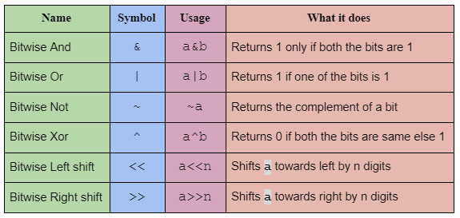
Bitwise Operations
https://iq.opengenus.org/addition-using-bitwise-operations/

Slide 26
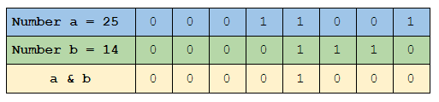
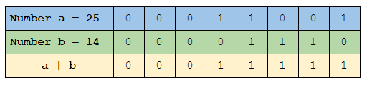
Bitwise Operations
https://iq.opengenus.org/addition-using-bitwise-operations/

Slide 27

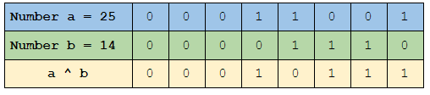
Bitwise Operations
https://iq.opengenus.org/addition-using-bitwise-operations/

Slide 28


Bitwise Operations
https://iq.opengenus.org/addition-using-bitwise-operations/

Slide 29
Practical Uses of Bitwise Operators
Check for odd and even numbers
  Warehouse example

Slide 30
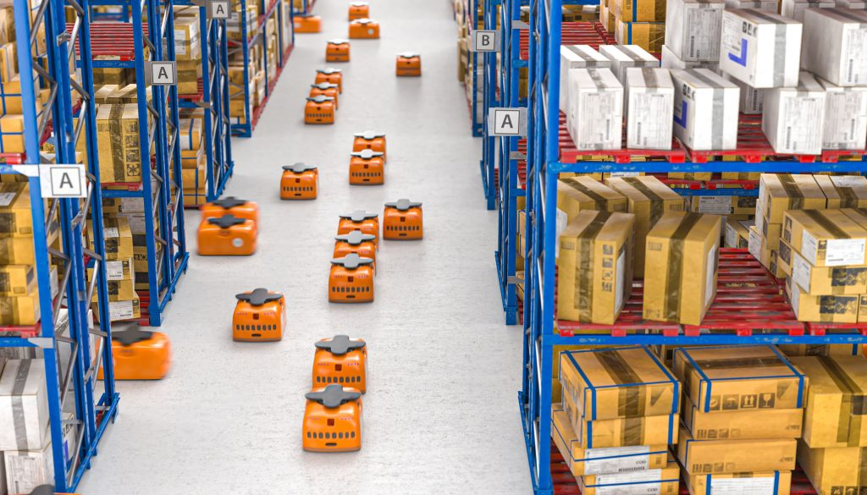

Slide 31
Shelves on the left = even numbers
(e.g. 2, 4, 506, etc.)
Shelves on the right = odd numbers
(e.g. 1, 3, 303, etc.)

Slide 32
Shelves on the left = even numbers
(e.g. 2, 4, 506, etc.)
Shelves on the right = odd numbers
(e.g. 1, 3, 303, etc.)
The robots get the shelf number to collect an item

Slide 33
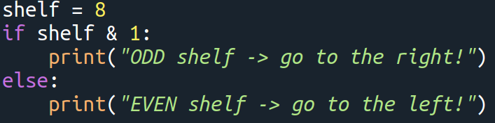
Shelves on the left = even numbers
(e.g. 2, 4, 506, etc.)
Shelves on the right = odd numbers
(e.g. 1, 3, 303, etc.)
The robots get the shelf number to collect an item

Slide 34
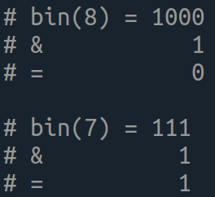
Shelves on the left = even numbers
(e.g. 2, 4, 506, etc.)
Shelves on the right = odd numbers
(e.g. 1, 3, 303, etc.)
The robots get the shelf number to collect an item

Slide 35
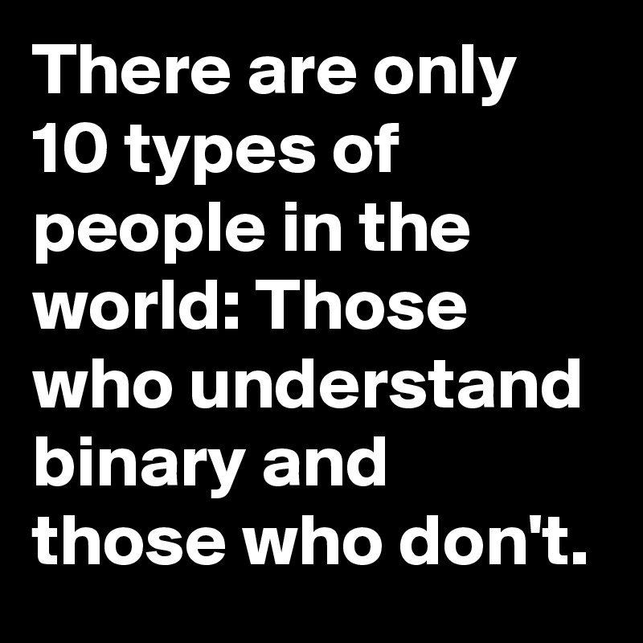

Slide 36
MasteryGrids
Python practice tool
  Developed at University of Pittsburgh
System: http://adapt2.sis.pitt.edu/kt/content/Show
Credentials:
  Blackboard → “My Grades”→ “MasteryGrids”
Book: Python for Everybody → https://www.py4e.com/book.php
Goal: use a educational tool to improve your knowledge of Python

Slide 37
MasteryGrids
Data:
  all user/usage data is completely anonymous
  researchers only will see, user: cotapp22sXX
  consent to use the data for research purposes
3% bonus on the final grade:
  sign consent
  at least 75% of the topics (6/8)
  at least 75% of the activities in each topic

Slide 38
To Do
Exercises for the week
  Use quarterfall to submit them
Work in Project 1
Try MasteryGrids (if you want)
Remember the “well-being and teamwork” intervention
  Blackboard → “Research area”

Slide 39
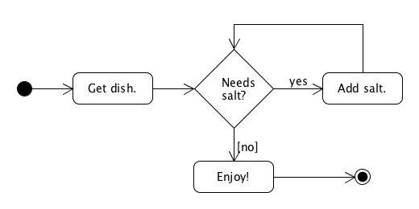
Next lecture
Loops

Slide 41


Slide 42




